Slide 1
FDM Print Bed Insulation Optimization
Vincent Di Gerlando
John McCaw
Claire Nelson

Slide 2
Project Background and Motivation

Slide 3
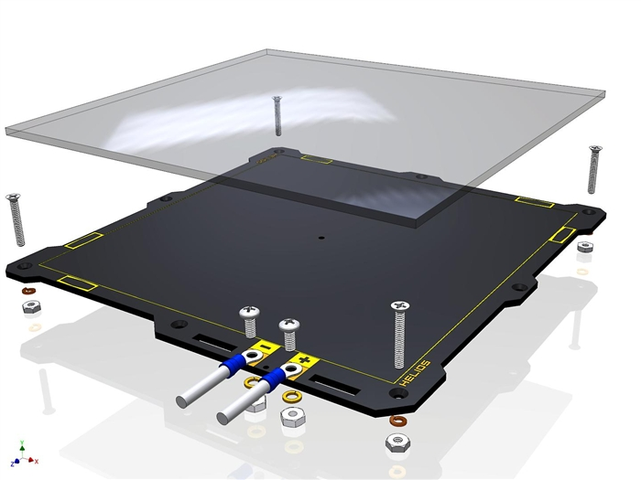
Problem Statement
In 3D printing temperature gradients and environmental fluctuations during Fused Filament Fabrication (FFF)are some of the leading factors that cause part failures due to bed adhesion.
Most printers incorporate an aluminum build plate with a resistive heater on the underside
Warping of a material is dependent on its temperature
Glass transition temperature is critical for good bed adhesion.

Slide 4
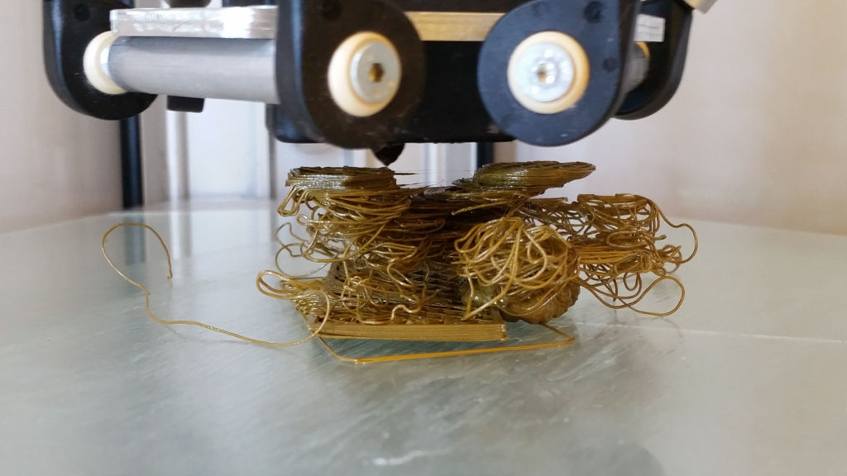
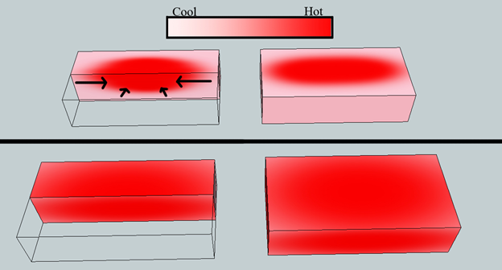
Goal:
To keep the printer bed at a constant temperature dependent on the material
PLA: 111-145 °F (Tg)
ABS: 105 ° F (Tg)
Proposed Solution:
Add different insulation patterns
In hopes that the corner regions that experience less heat transfer from the resistor plate will become more equal to the center region
Translating into a better and more uniform bed adhesion

Slide 5
Experimental Design and Setup

Slide 6
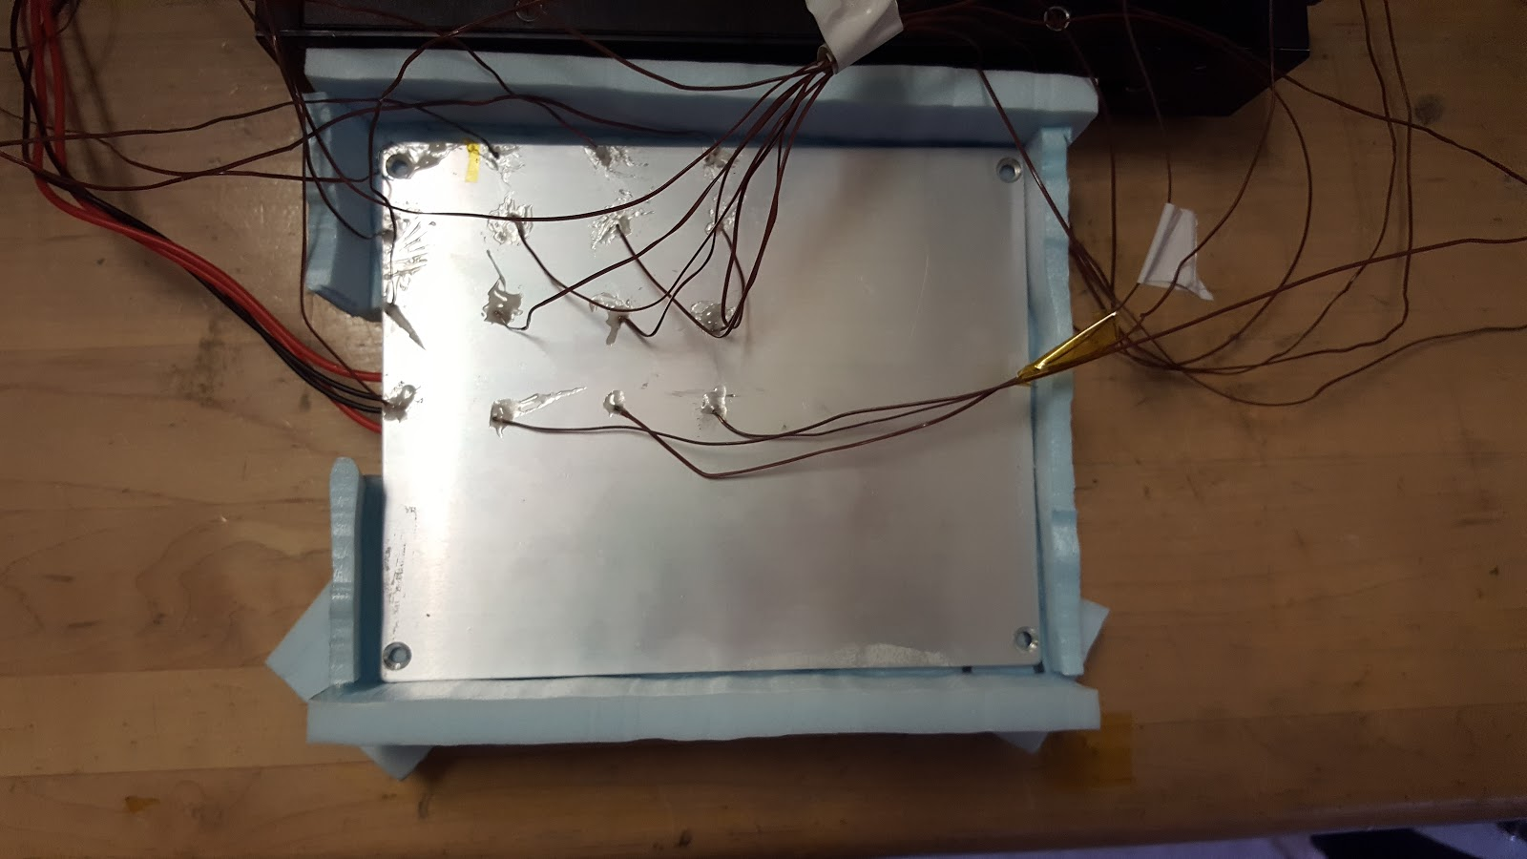
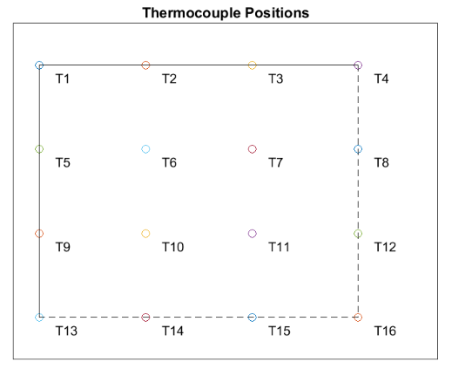
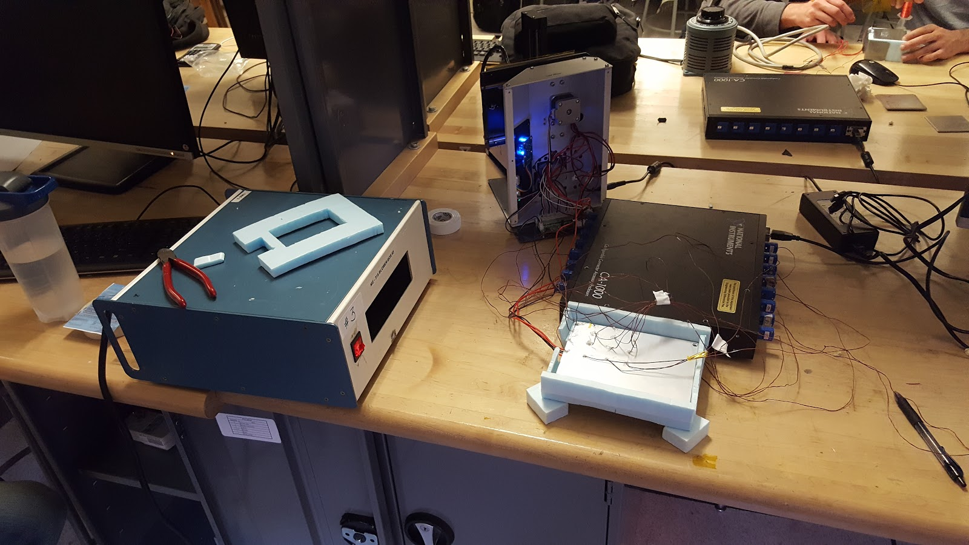
Experimental Setup
The stand alone heat bed was powered using a 3D printer
16 thermocouples equally spaced were attached at the top surface of the plate
Five different cases were analyzed including one independent case and four cases dependent on insulation design

Slide 7
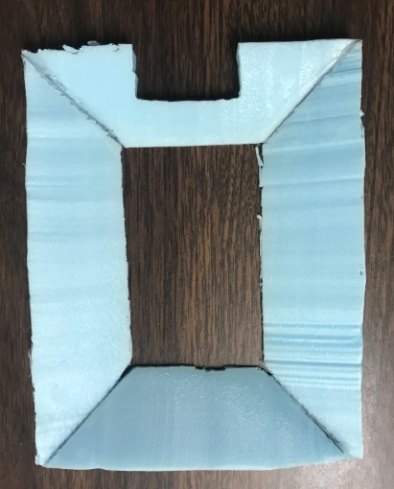
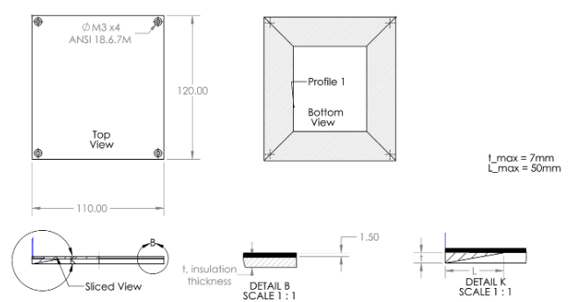
Linear Insulation Profile
Case 2: Linear Profile

Slide 8
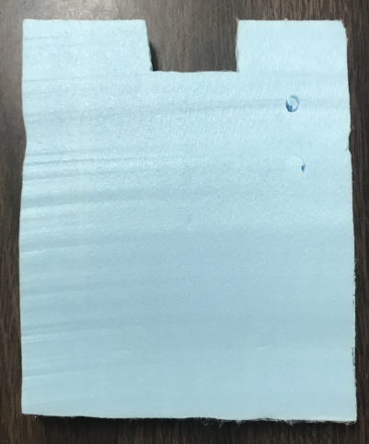
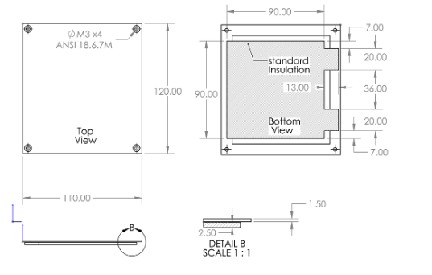
Traditional Insulation Pattern
Case 3: Constant Profile

Slide 9
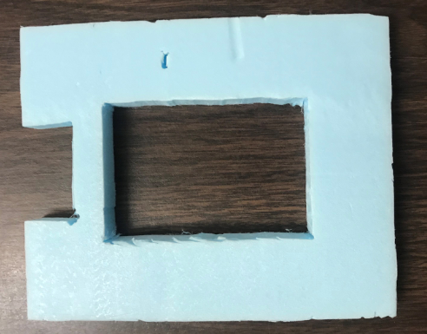
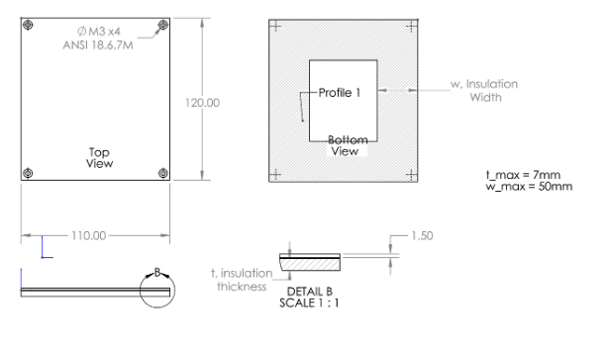
Square Insulation Pattern
Case 4: Stepped Profile

Slide 10
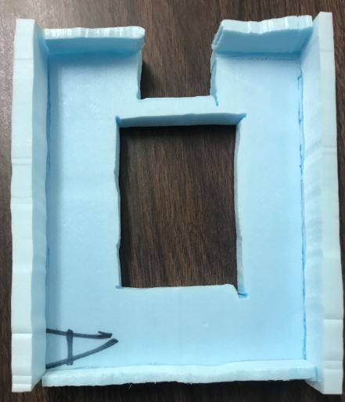
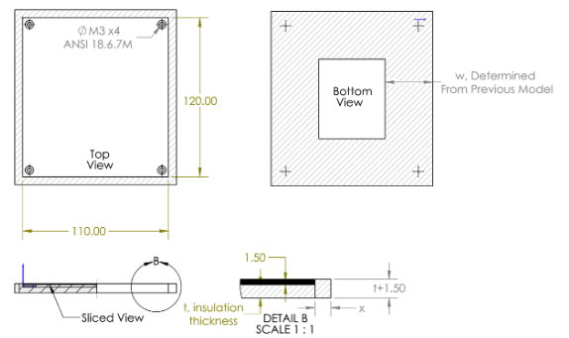
Side Insulation Pattern
Case 5: Stepped profile with Raised edges

Slide 11
Heat Transfer Analysis

Slide 12
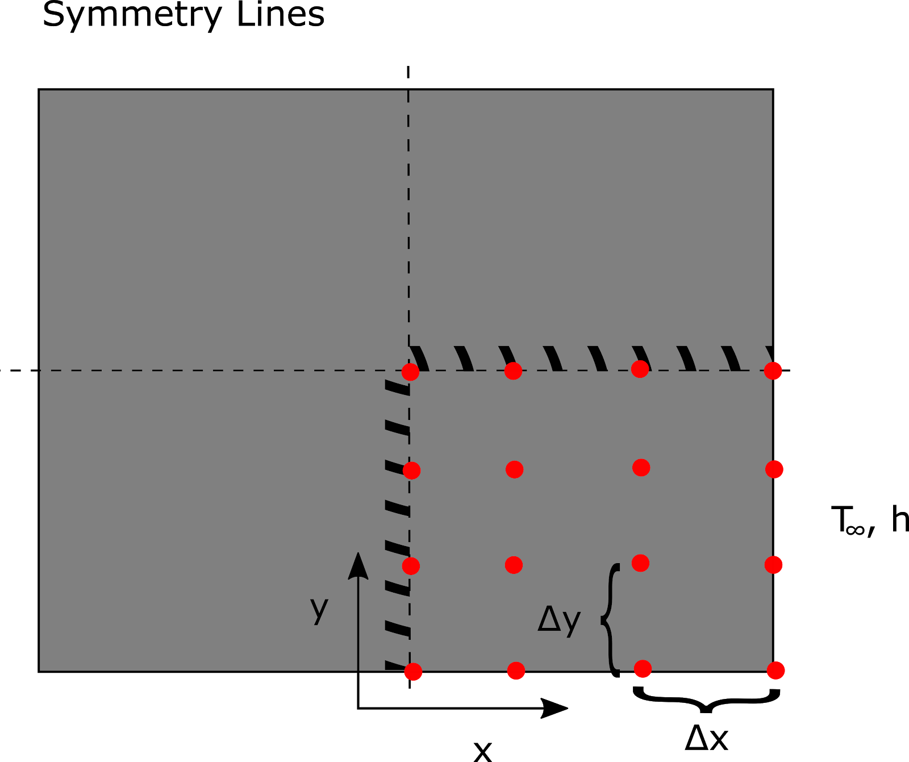
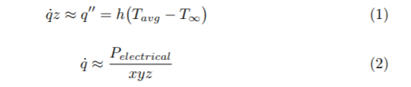
Analytical Approach
A 3D solution to the Heat Equation is non-trivial, not a helpful design tool
Energy Balance will allows computing relevance of radiation, bulk properties
From the analytical approach, it’s symmetrical:

Slide 13
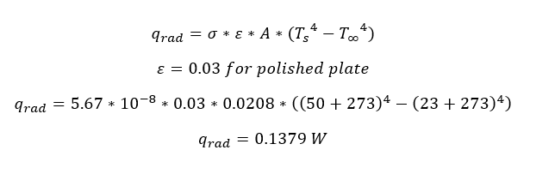
Assumptions
Radiation and Conduction heat transfer are negligible
Perfectly insulated at bottom
Neglect heat transfer into the wire
No contact resistance on thermocouple

Slide 14
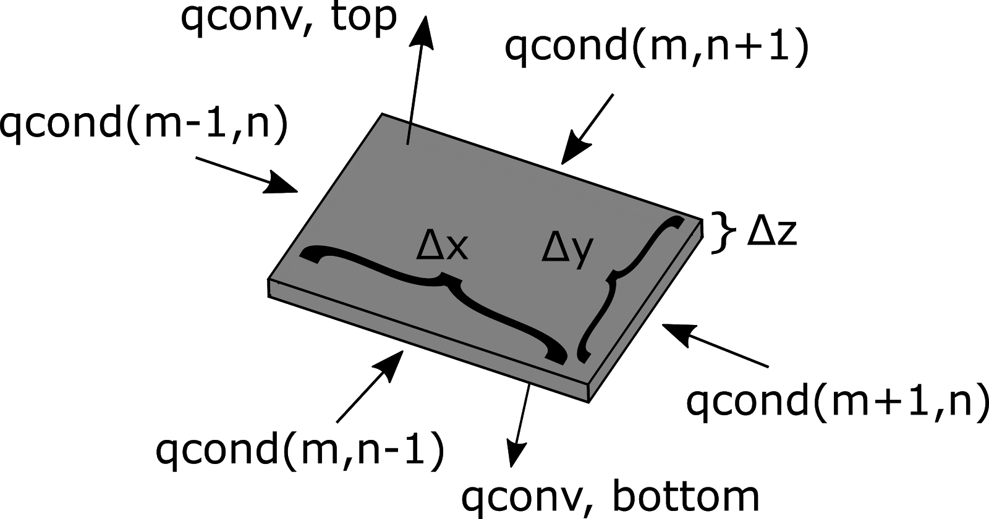
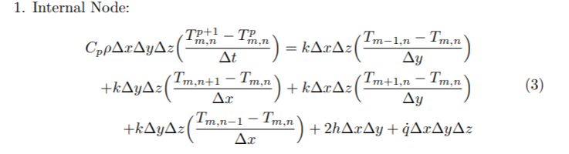
Numerical Approach
From this, we can develop unsteady finite difference equations for the different plate elements;

Slide 15
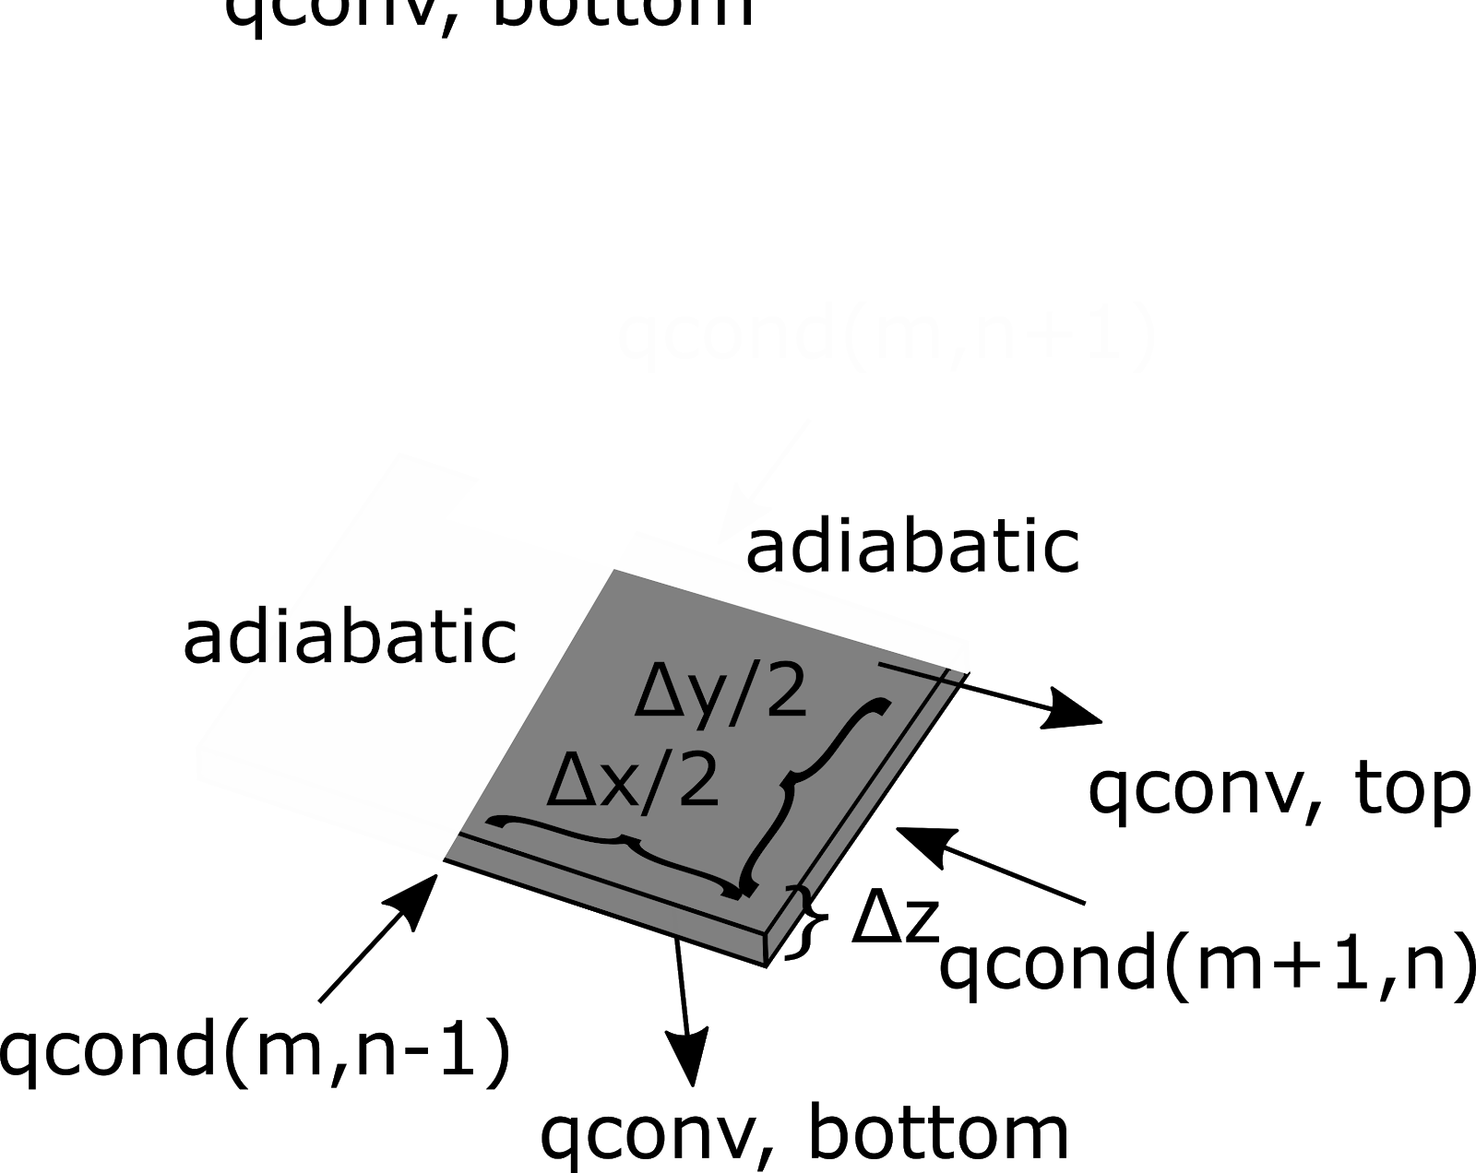
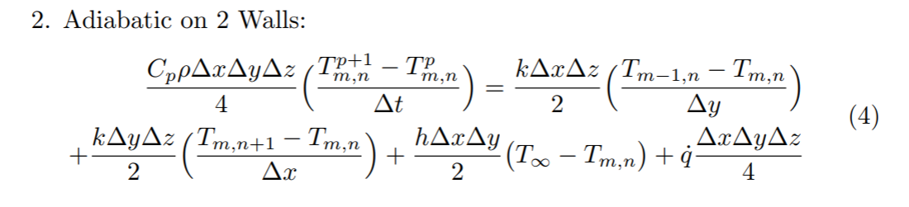
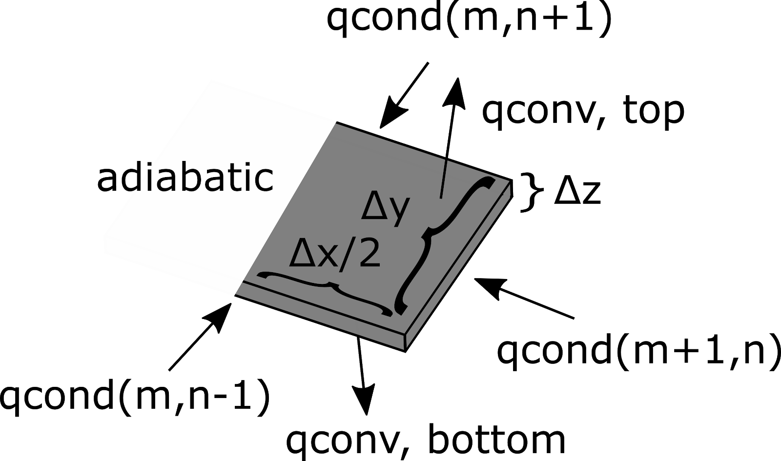
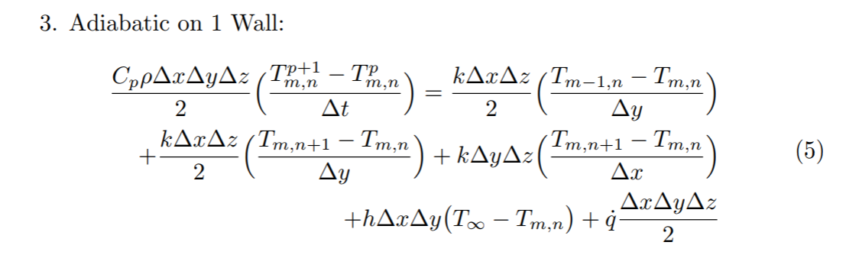
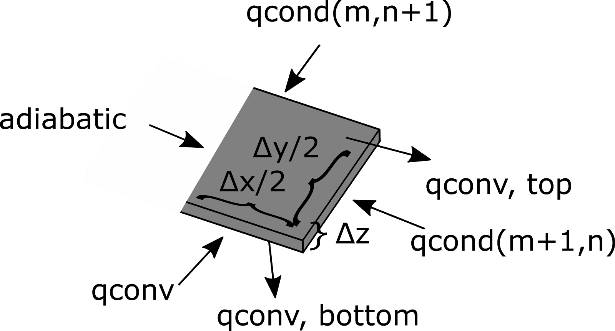
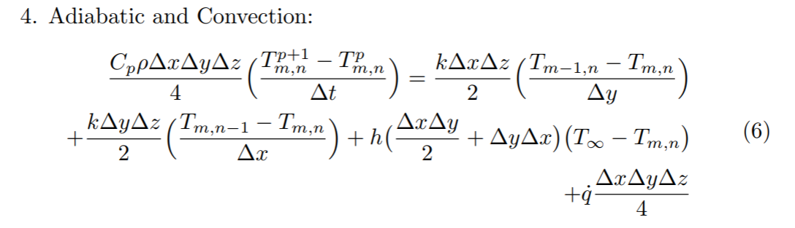

Slide 16
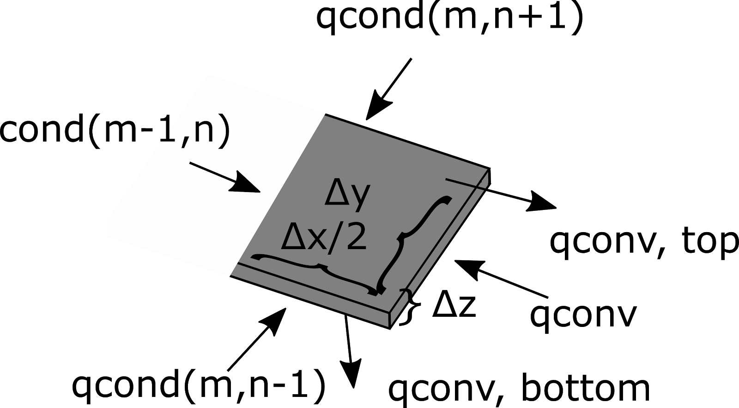
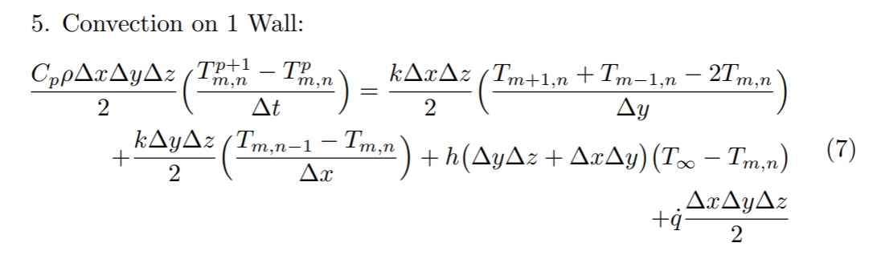
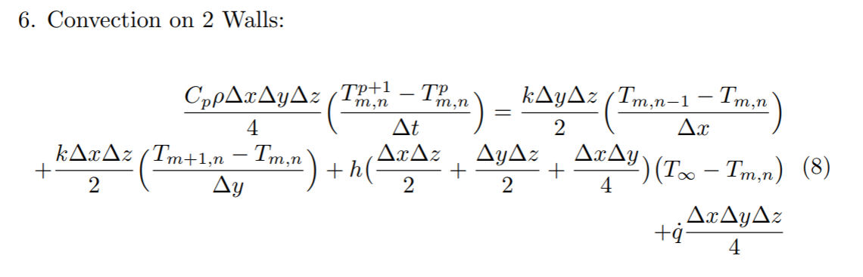
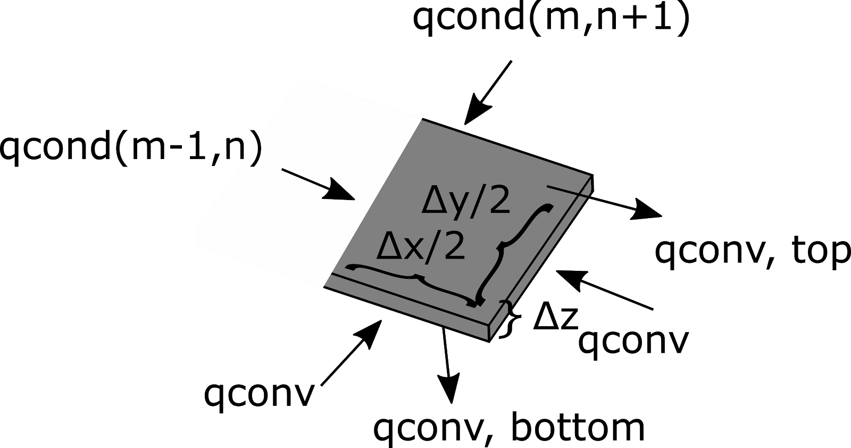
These difference equations can be used to predict how altering heat transfer in one node affects the heating of the overall plate.

Slide 17
Results

Slide 18
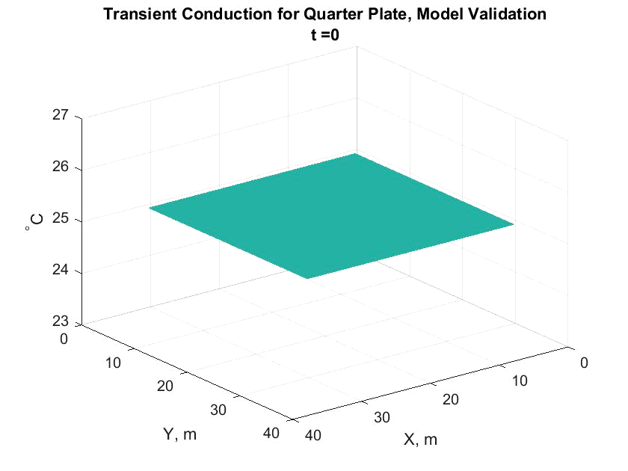
No Insulation Temperature profile

Slide 19
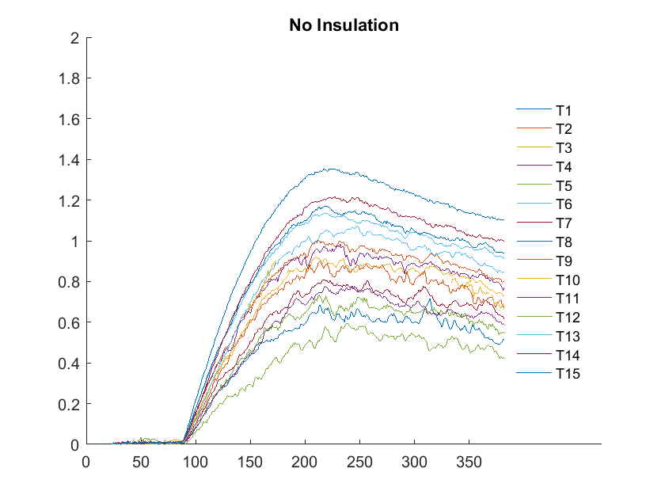
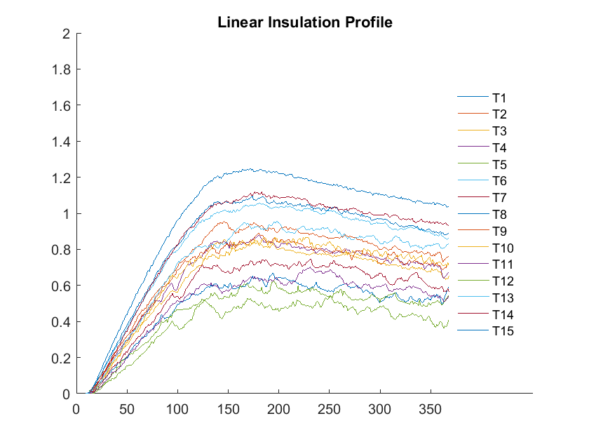
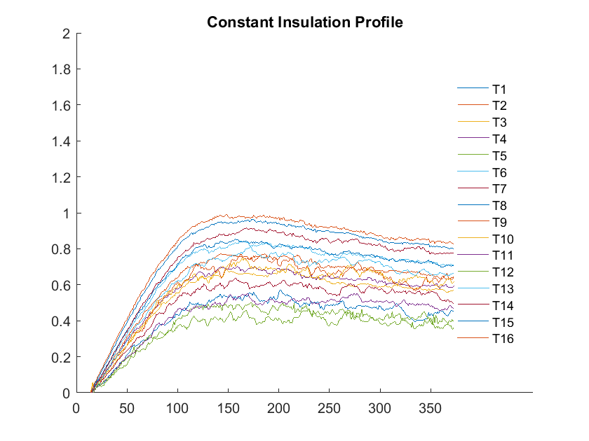
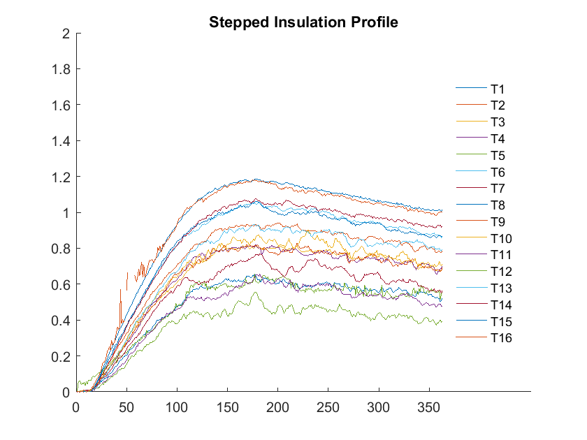
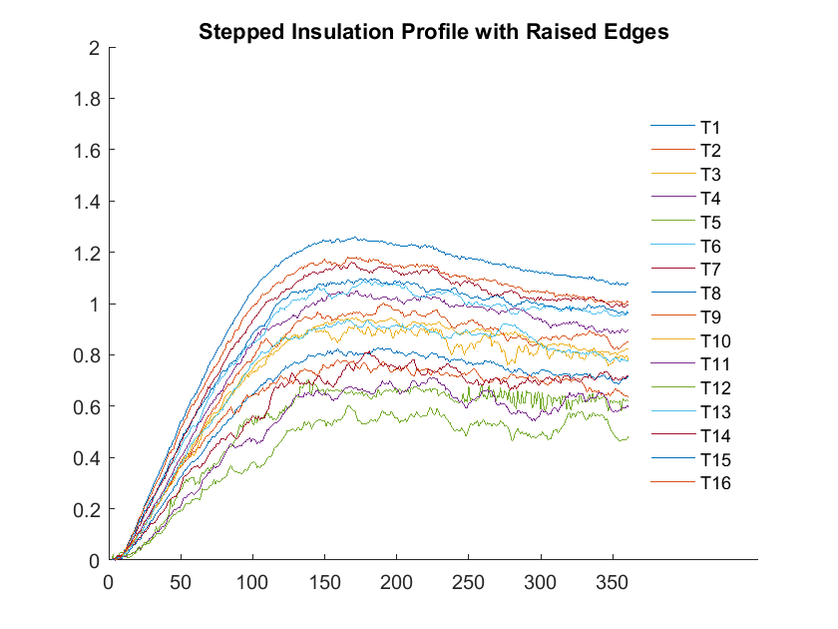
Temperature vs. Time

Slide 20
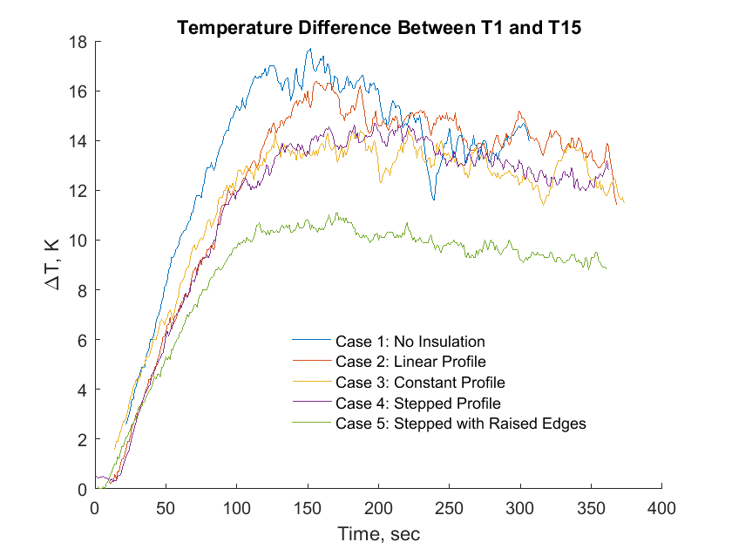
Change in temperature vs time

Slide 21
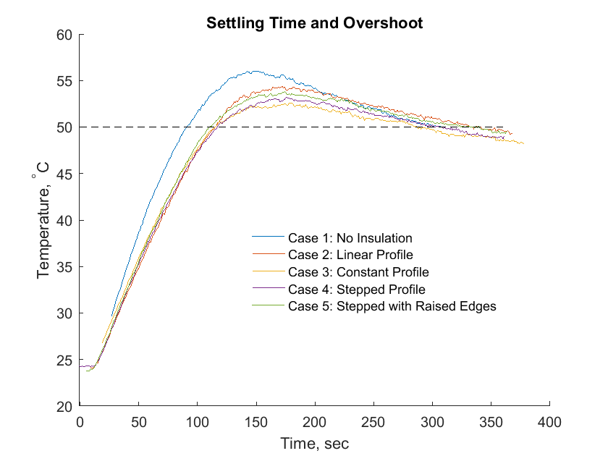
Temperature vs time for thermocouple number 15
Insulation Case | Overshoot [%] | 2% Settling Time [s]
Case 1 | 12 | 323
Case 2 | 8.8 | 293
Case 3 | 5.2 | 220
Case 4 | 6.32 | 270
Case 5 | 7.6 | 278

Slide 22
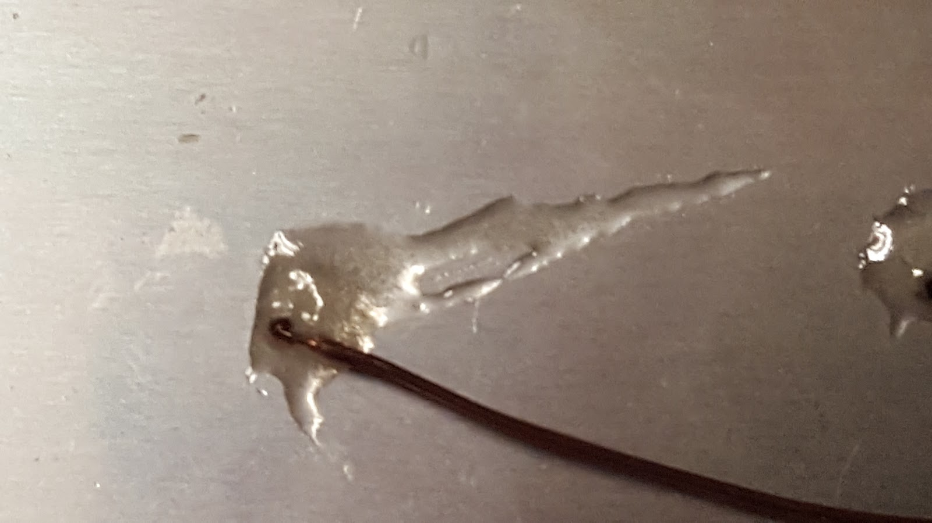
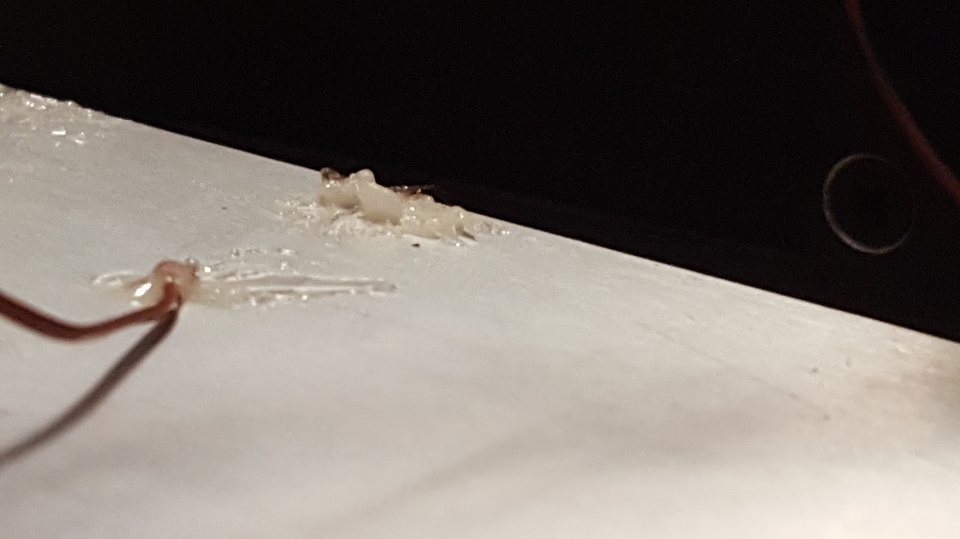
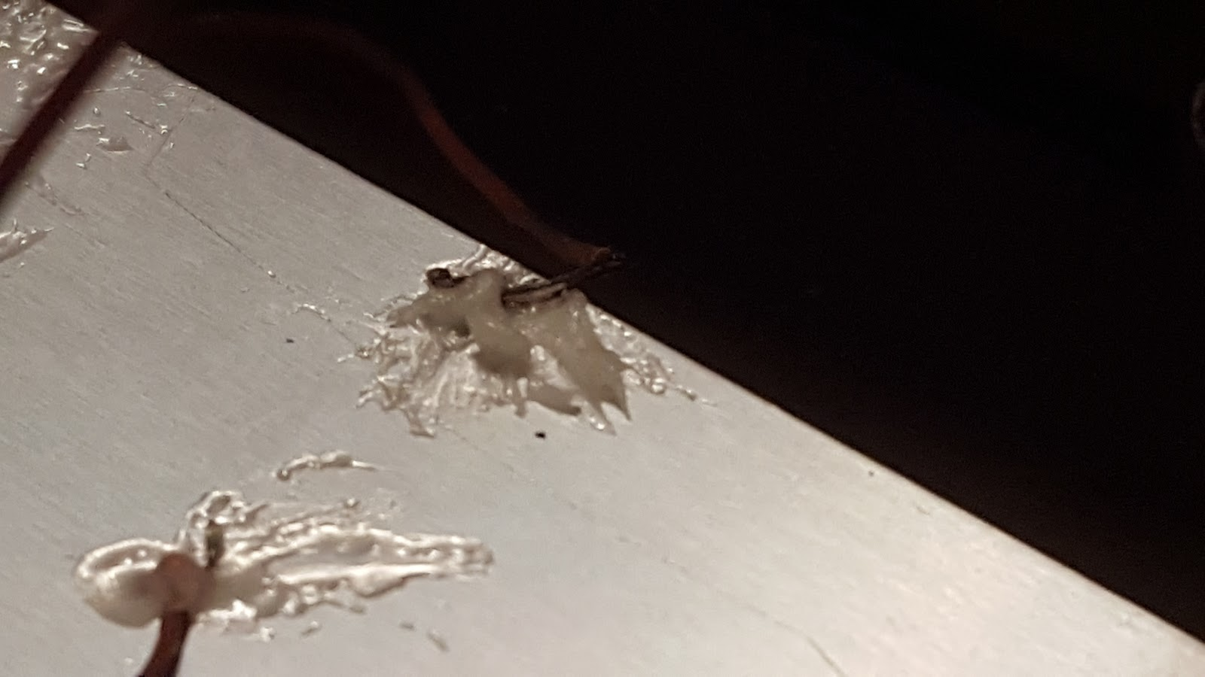
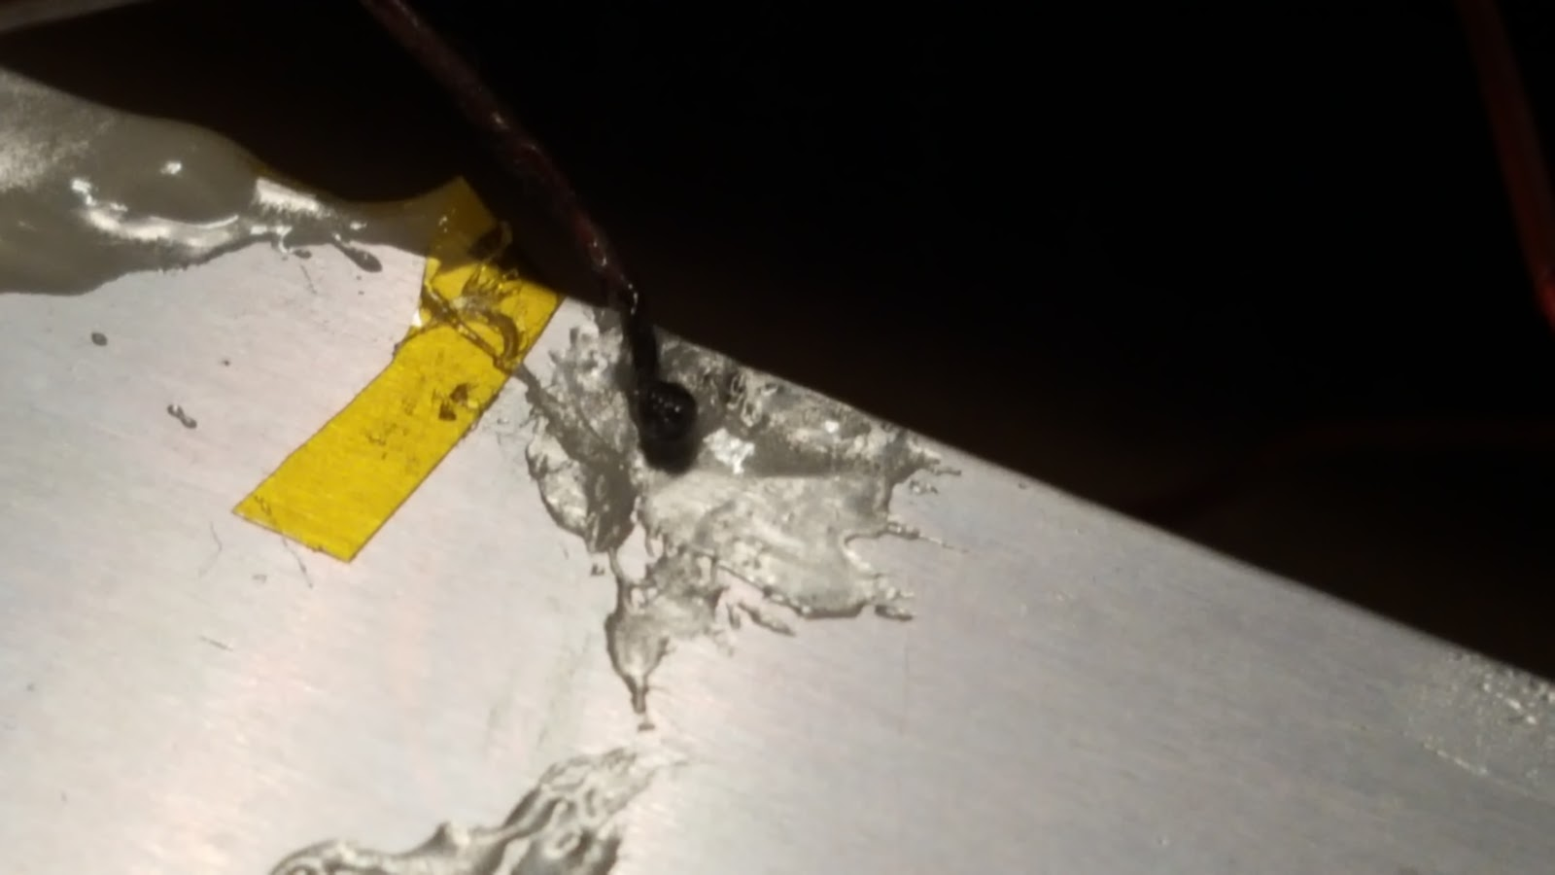
Sources of Uncertainty
Errors with Thermocouples:
Positional Error (a)
Added Mass (b)
Epoxy under the thermocouple (c)
Non-uniform epoxy (d)
a
b
c
d

Slide 23
Conclusions and Future Work

Slide 24
Conclusion
Additive manufacturing is reaching an inflection point
Component optimization is becoming crucial to future developments
A constant insulation profile with single sensor feedback is not the most effective method for uniform heating.
A stepped, edged profile allowed for the most uniform bed temperature.
All had similar overshoot responses - insulation is not a good solution to fix overshoot issues with heating.
The cost of bettering the insulation profile is lesser than bettering the controls/heating method and is a viable solution financially.
Max Temp Diff | 17 Deg C | No Insulation
Min Temp Diff | 8 Deg C | Stepped Edge

Slide 25
Future Work
Future work would benefit from a more detailed resistance model:
Contact Resistance
Higher fidelity meshing
Modelling of regional insulation
Redesign of controls system to lessen overshoot with a better model of printer temperature
Experiment with effect of insulation material on bed performance

Slide 26
Citations
Incropera, Frank P., and David P. DeWitt. Software Tools and Users Guides to Accompany Fundamentals of Heat and Mass Transfer, Fifth Edition & Introduction to Heat Transfer, Fourth Edition. Wiley, 2002.

Slide 27
Questions?

